Slide 1

Vehicle Health Analysis and Spare Parts E-Commerce
SRM INSTITUTE OF SCIENCE AND TECHNOLOGY
SCHOOL OF COMPUTING
DEPARTMENT OF DATA SCIENCE AND BUSINESS SYSTEMS
18CSP107L - MINOR PROJECT
Student 1 Reg. No:RA1911027010058
Student 1 Name: YUVRAJ SINGH CHAUHAN
Student 2 Reg. No: RA1911027010007
Student 2 Name: AVINASH REDDY VASIPALLI
Guide name: T. KARTHICK
Designation: Assistant Professor Department: DSBS

Slide 2
Table of Contents
Introduction
Objectives
Literature Survey
Architecture Diagram
UML Diagrams
Algorithm Used

Slide 3
Introduction
The global e-commerce automotive aftermarket size was valued at USD 53.78 billion in 2020 and is expected to expand at a compound annual growth rate (CAGR) of 14.6 % from 2021 to 2028.
The rising need for people and independent retailers to access more affordable automotive parts for sale in the aftermarket offers an impetus to the market.
Vehicle systems are complex both in hardware and software so their maintenance is challenging.
Maintenance strategy being used in vehicle industry is normally reactive that results in reduction of lifetime of vehicle and also loss of money, thus predictive maintenance is required on this stage to overcome these issues.
This ongoing trend of pure-play retailers deploying e-commerce strategies is projected to fuel the growth of the market.

Slide 4
Problem Statement
Analyze the information such as distance travelled since the time it is active, years used, model of car, and other factors to estimate the insurance amount to be paid and give maintenance alerts if required.
Give an option to the customer whether they like to order a technician to do the work or the customer themselves do it if they have the knowledge, however choosing the later will not give any warranty or free replacement if anything goes wrong.
Estimate the insurance claim that would be received by the customer due to faults caused by some unforeseen circumstances.
The system will also provide e-commerce support where in, if the issue is with a particular part then that particular part will be searched online and displayed to the customer by using the NLP model.

Slide 5
Objectives
Historically, technicians were called in order to assess the problems which the car has and they would suggest the estimated cost for fixing the issue as well.
In that system the chances of scamming the customers, not properly fixing the fault, not paying the insurance money to the customer due to lack of evidence and asking money way too much than the actual amount was common.
E-vehicle health monitoring and commerce systems were thus introduced to combat this problem from the market and provide a fair assessment for the problem at the best cost.
The current vehicle health monitoring systems uses ML algorithms to determine the condition of the vehicle and provide diagnosis for the same.
The replacement for the faulty parts is provided by the system at a minimum cost which is then installed by the technician.
If however the fault is there due to some unforeseen circumstances, diagnosis is done and the insurance money is paid to the customer.

Slide 6
Literature Review
Title | Methodology | Observation
Vehicle Health Monitoring and Analysis May 2016, Parmesh K. R | Modern vehicles are integrated with more number of ECUs and sensors which make them smarter in terms of engine decisions, performance, fuel efficiency, security and stability. | ECUs provides useful data in the form of diagnostic codes via OBDII (on-board diagnostics) protocol, these codes determine a specific issue in the vehicular system which is used by service technicians to address the issues occurred.
A Vehicle Health Monitoring System Evaluated Experimentally on a Passenger Vehicle October 2006, Hok K. Ng, Robert H. Chen, Jason Speyer | A residual generator and a residual processor are designed together to detect and identify actuator and sensor faults of the Buick LeSabre rapidly. The residual generator includes fault detection filters and parity equations. | A real intermittent sensor fault occurred and was immediately detected and identified. The real-time evaluation demonstrates that the vehicle health monitoring system can detect and identify actuator and sensor faults under various disturbances and uncertainties with almost minimal detection latency.

Slide 7
Title | Methodology | Observation
Automotive vehicle Health Monitoring and Damage Detection System February 2022, Shankar D. Birajdar, Atul R. Saraf, Nilesh G Patil | A damage detector is affixed to a surface of a material for detecting a damage or crack inside the material or vehicle body. In response to detecting a damage, a damage indicator is generated, A microstrip antenna /nanostrip antenna communicates the damage indicator to an external device. | The microstrip antenna detects the damage and the time when the damage was detected. Additionally, the antenna may associate other information with the damage indicator such as temperature and acceleration information.
Demand Forecasting for Motor Vehicle Spare Parts January 2012, J. J. Strasheim | A variety of alternative forecasting techniques were evaluated for this purpose with the aim of selecting one optimal technique to be implemented in an automatic reordering module of a real time computerized inventory management system. | Vehicle spare parts selected the optimal technique to forecast vehicle parts for the upcoming future so that the stock for those parts can be replenished.

Slide 8
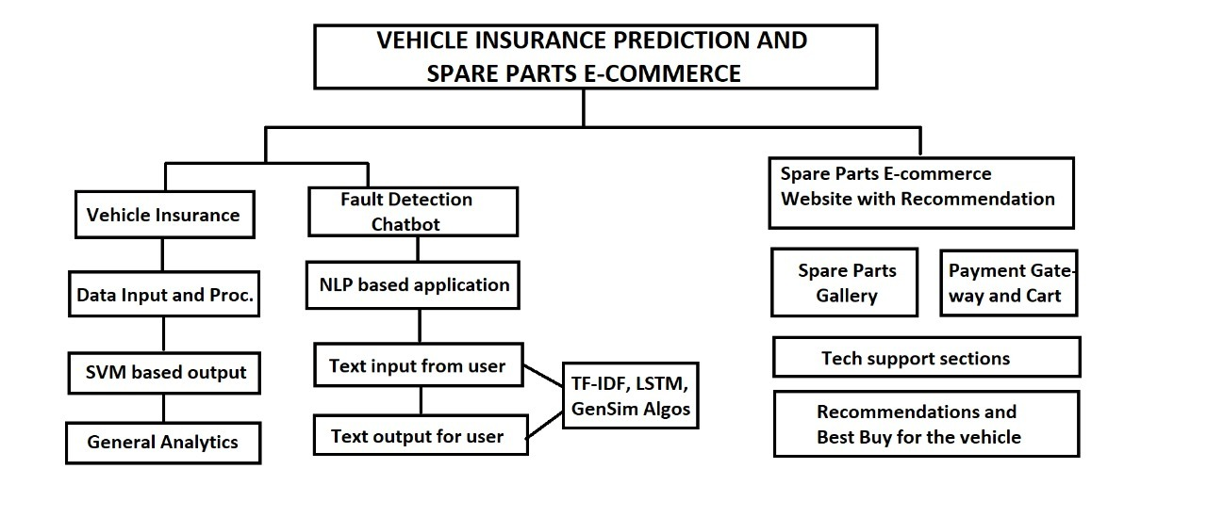
Architecture Diagram

Slide 9
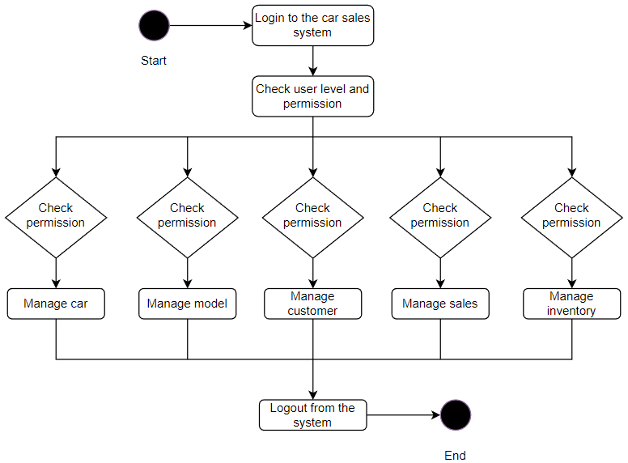
UML Diagrams
Activity Diagram

Slide 10
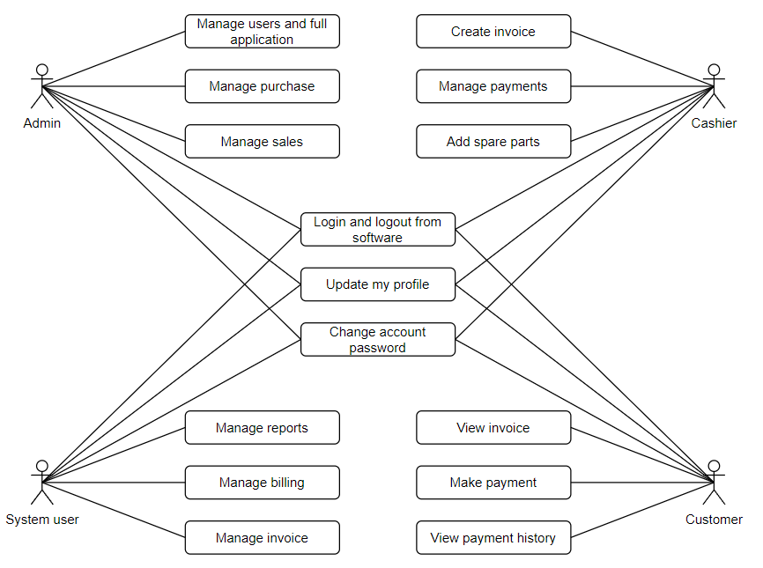
Use Case Diagram

Slide 11
Algorithms Used
Support Vector Regression:
SVMs or Support Vector Machines are one of the most popular and widely used algorithm for dealing with classification problems in machine learning. This algorithm acknowledges the presence of non-linearity in the data and provides a proficient prediction model. The SVM regression algorithm is referred to as Support Vector Regression or SVR. In machine learning, Support Vector Machines are supervised learning models with associated learning algorithms that analyze data used for classification and regression analysis. In Support Vector Regression, the straight line that is required to fit the data is referred to as hyperplane. The objective of a support vector machine algorithm is to find a hyperplane in an n-dimensional space that distinctly classifies the data points. The data points on either side of the hyperplane that are closest to the hyperplane are called Support Vectors. These influence the position and orientation of the hyperplane and thus help build the SVM.
This algorithm allows scanning through multiple parameters and understand the nature of insurance premium depending on varied factors of cars and bikes.

Slide 12
TFIDF and LSTM:
These have been used in the NLP part of the application where an user can input his or her problem statement and the autobot will be replying in human understandable sentences and also suggest a best buy from the website.
TFIDF stands for term frequency and inverse document frequency. This model finds out the most stressed words and the problem topic and helps to find a solution accordingly. LSTM stands for Long short term memory. LSTM model is used to find the sequentiality in the text. This means that in a sentence, the LSTM model will consider the words in continuation as a human reads a sentence and not pickup individual words and analyze the meaning. This is particularly helpful while answering the user in sentence and this can be very useful for unforeseen use cases as well.
The third part is a simple ecommerce website with admin panel facilities made using PHP and MySQL. The purpose of this is to sell the spare parts and also provide free replacement facilities for the customer.

Slide 13
Thank You

